Slide 1
INDIA - UAE BUSINESS COUNCIL
KICK OFF: 14th March 2023
WOMEN´S INDIAN CHAMBER OF COMMERCE AND INDUSTRY
www.wicci.in

Slide 2
Council Vision & Mission
VISION
MISSION: Women envisioning Global Impact for Women Entrepreneurs, Businesswomen and Professionals from all walks of life.
VISION TO BE EVOLVED AS PART OF COLLECTIVE DIALOGUE AMONG COUNCIL MEMBERS
Together, we can be the change and seek the change

Slide 3
What is WICCI?
A National Business Chamber for Women, Women’s Indian Chamber of Commerce & Industry, (WICCI) boosts and builds women’s entrepreneurship and businesses through greater engagement with government, institutions, global trade and networks.
250000 members
10000 office bearers
Recommendations to relevant government authorities
Engage in community outreach and
Collaborate with a variety of institutions
600+ Councils
160+ Sectors
100+ Countries
3 National Boards

Slide 4
OUR COMMITMENT
Develop policy frameworks for incentives and concessions
Mainstream women’s voices and uphold women’s interest, voice and visibility at multiple levels
Hold programs, webinars, conferences, and especially around how to: raise funds, structure businesses, increase market share, drive sales, improve branding, and enable B2B collaborations
Help mitigate our many challenges and boost business prospects through networking and mentoring
Collaborate across councils in India and abroad in mutual exchange and empowerment, boosting business-to-business interaction and economic activity
Build Media Presence to strengthen women’s voice and leadership
Empower the competitiveness of Businesswomen, Entrepreneurs and Professionals, toward enhancing our economic inclusion and business growth overall.
Policy Change
Mindset Change
Societal Transformation through Action

Slide 5
Role of the Bi Lateral Council
Bilateral Business Councils: There are bilateral councils with 100+ countries for global exchange and developing business connections and collaborations with women in India and abroad.
Bilateral Business Councils develop business opportunities for their members globally. They are not sector specific, but multi-sectoral. Their role is to coordinate with our sector specific State and National councils, and other bilateral councils as needed for business relations and expansion.
Together, we can be the change and seek the change

Slide 6
WICCI IN UAE BIZ COUNCIL Charter 2023
HUB @ Work
Handling Unconscious Bias at Work
Enable young working women to build sustainable careers and tackle critical career challenges addressing the issues of "Unconscious Bias" at workplace. How to grow ones career while navigating Unconscious Bias around 3 Ps
1. Promotions: planning for promotions and ensuring Unconscious Bias doesn’t hold you back
2. Projects: Equal opportunity to work on critical Projects
3. Parenting: Ensuring work Life Integration without succumbing to Unconscious Bias at Work
Our roadmap of 2023 under WICCI INDIA-UAE will focus on
“Young working women navigating lifestyle changes”
Together, we can be the change and seek the change

Slide 7
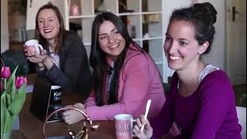
WIIFM: what’s in it for me?
OPPORTUNITY TO MAKE A DIFFERENCE
GREATER MEANING AND PURPOSE
PEER GROUP LEARNING
STRENGTHENING YOUR GLOBAL NETWORK
ACCESS TO LOCAL AND GLOBAL MARKETS & BUSINESS OPPORTUNITIES

Slide 8
Welcoming Council Members to
WICCI
President, Vice President
and 20+ Nominated Council Members

Slide 9
INDIA UAE COUNCIL
Dr Harbeen Arora
Founder and President
G 100 ALL WEF WICCI SHECONOMY

Slide 10
Member Profiles

Slide 11
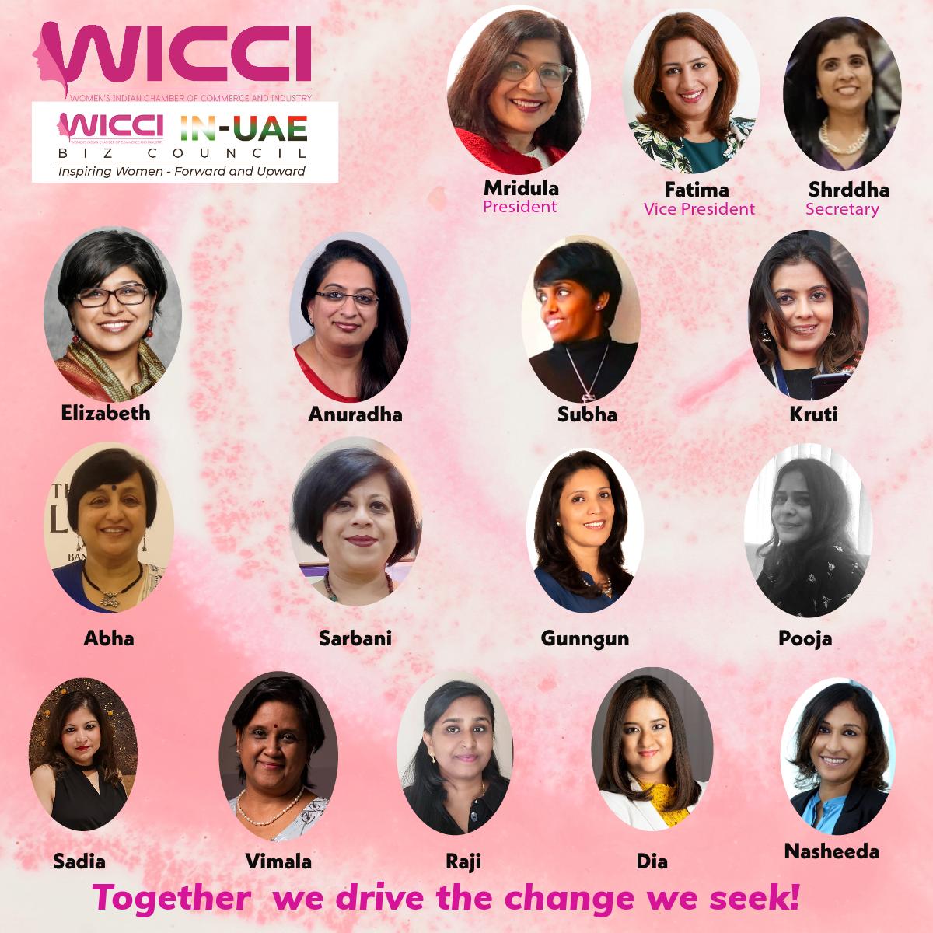
WICCI Members 2023

Slide 12
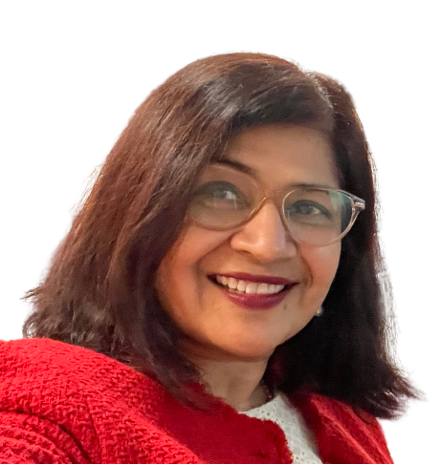
Mridula Sankhyayan, PRESIDENT
INDIA and UAE Business COUNCIL, WICCI
Mridula Sankhyayan, is the founder of Vatt Vriksh Consultants a Talent Development Consulting and Coaching firm. In her previous role she was the Chief Executive Officer at Global Talent Track, a Talent Resourcing, Skilling and HR Consulting organization that facilitates employment for thousands of youth from diverse backgrounds. Prior to this she has worked with large multinationals like Genpact, Nomura, Goldman Sachs and Flipkart. “It is my belief that each individual has ability to maximize their potential by harnessing their strengths and overcoming their limiting beliefs. I see tremendous opportunity for Individual and organizational growth in current dynamic market environment. Leaders have a responsibility to lead people and drive business results with courage and foresight.” She is a fellow of Aspire India on Enlightened Social Leadership, a Trustee on the board of Educait, an NGO for underprivileged children. She writes regularly for Business HR Magazine. In her free time Mridula paints, writes, meditates and spends time with her children.

Slide 13
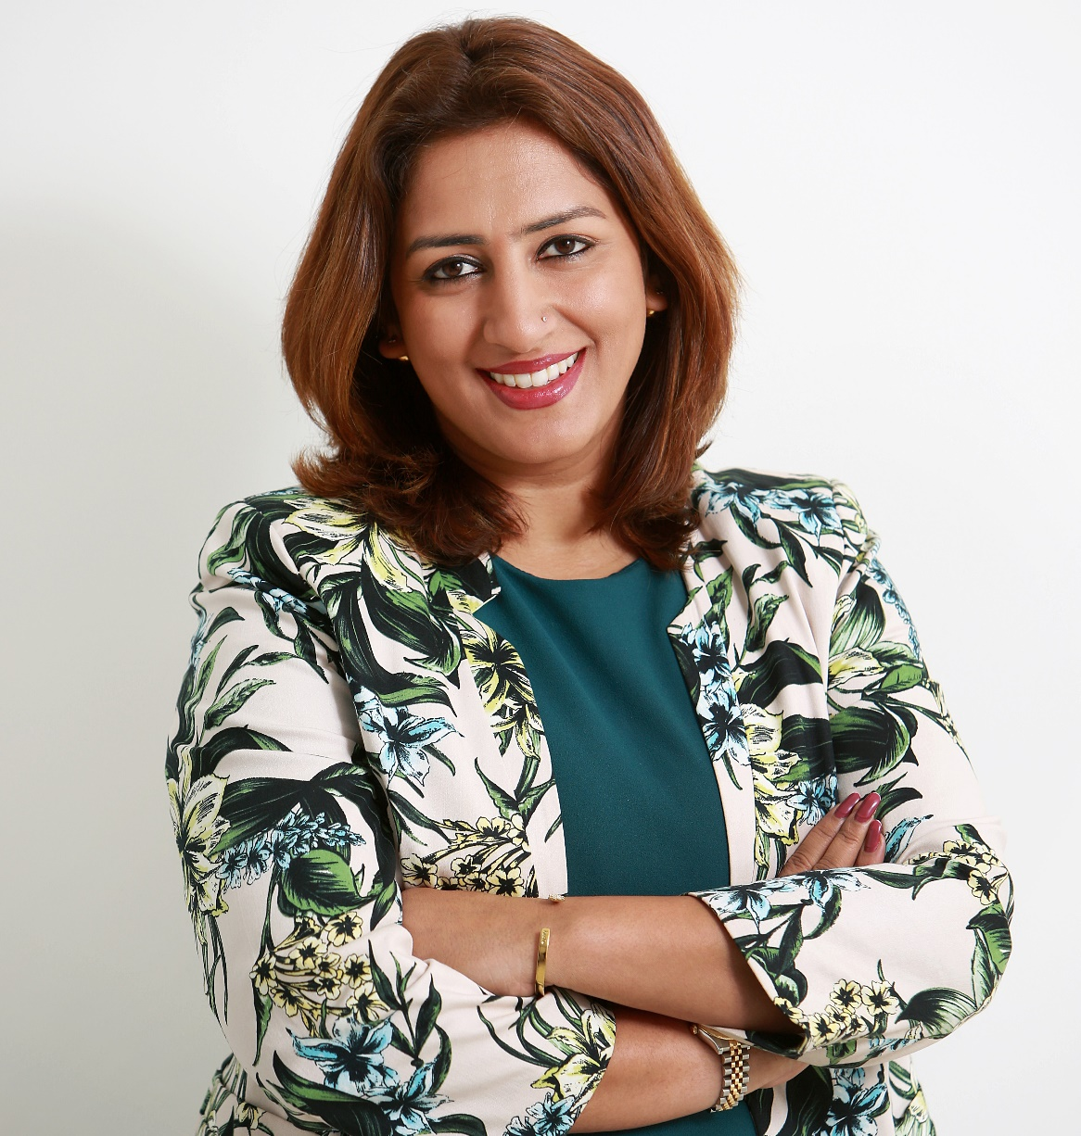
Fatima Shaikh, VICE PRESIDENT
INDIA and UAE Business COUNCIL, WICCI
Fatima is the Content Head for Radix Media MENA. She is an Advertising & Content professional, with a background in media and advertising, specializing in brand and product content communications, digital marketing, social media and activations. Over 19 years of experience in the UAE, including 12 years in a senior role within the advertising sector. Deep understanding of the personas and media habits of existing and potential brand customers to help deliver effective and targeted messaging across media platforms.

Slide 14
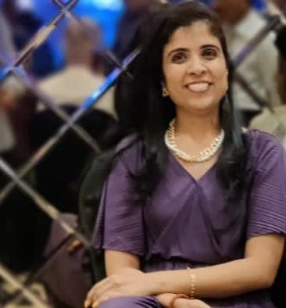
SHRDDHA SHETTY, SECRETARY, INDIA and UAE Business COUNCIL, WICCI
Advisor for Outreach, Research and Strategic Partnership in startup ecosystem focus on socio tech domain| Independent Business Consultant| Ex-corporate Strategy & Business Analyst @ Accenture (North American, UK market) & Capgemini (EU market)| Mentor of Change @ Atal Innovation Mission for Atal Tinkering Lab by NITI AYOG teaching social entrepreneurship to young minds school students| Research Contributor for Millet Revival Project @TheLocavore in association with Rainmatter Foundation| Outreach, Partnerships, User acceptability, Products, Policy and Design of Digital Public Goods @ e-governance DIGIT projects to transform how cities and citizen work together| Startup Mentor focusing Women Entrepreneurs, Student Entrepreneurs, Women returning to work and under-resourced talents| National Startup Council Member @ WICCI India| Passionate about Social Impact Initiatives| Advocate of Equality and empowerment, Diversity & Inclusivity| Travel, culture and Food Enthusiast (Articles featured on BBC Good food, Times Food, Zee zest, The Hindu)| Bharatnatyam & Contemporary trained, Dance enthusiast and Creative art admirer| Learner for life| Believer of work life balance| Appreciate simple, genuine and humble conversations| ~PGDIBS (IIFT, Delhi), BE in computers (Mumbai), Startup Pre-incubations (CIIE CO IIM A, NSRCEL IIM B), Startup certifications (Startup India, Y Combinator), CBAP BOOTCAMP (IIL), SIX SIGMA GREEN BELT (IACT), CAD (MIT PEP), NCFM (NSE)

Slide 15
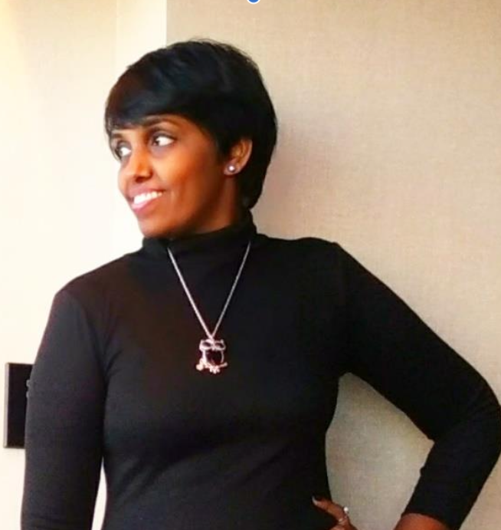
Subha Pandyan, Council Member
INDIA and UAE Business COUNCIL, WICCI
I am a Diversity strategist and an Inclusive culture professional with a proven track record of progressive experience leveraging diversity and inclusion, employee relations, and solid work ethics to drive organizational performance and success. Manage diversity metrics, workforce optimization, and affirmative action initiatives. Skilfully align HR & diversity management strategies with a corporate mission while ensuring compliance with policies & practices. Conducts thorough strategic & organizational planning for identifying and improving processes & procedures to enhance business operations and employee needs within work-life balance & diversity programming. Expert in diverse social, civic, and cultural event planning.
As a Diversity and Inclusion practitioner, my personal mission is to be a conscientious change agent and disruptor in increasing representation and belonging in every space. That mission has guided me in the D&I space where I manage and lead D&I initiatives across major global organizations. I Design, Direct and Execute Inclusive practices for Educational Institutions, Workspaces, and communities.
In my last 25 years of corporate Experience - As an authority in Strategy, Productivity, and Growth – I have carried a unique, hands-on, and intervention-styled approach to rapid change. I have been coaching companies, Leaders, teams, and individuals to achieve Company goals with specific Business skills - I am a Certified Six Sigma Master Black Belt, CMMi trained on Version 1.3 of the SCAMPI Methodology – SEI Certified, Certified Lead Auditor for ISO 9001:2008 QMS, ISO 27001 – ISMS – Internal Auditor, Certified Lean Implementation Expert, COPC CSP Certified, CXJM - Certified Customer Experience Journey Mapping Expert, AGILE Coach, and Neuro-linguistic practitioner

Slide 16
Vimla Sheshadri, COUNCIL MEMBER INDIA and UAE Business COUNCIL, WICCI
Vimala is a well-seasoned leadership facilitator and executive coach with over twenty-five years of corporate experience across several industries and holding different senior level positions. Vimala was born in India and raised in the United States. She completed her PhD in Pharmacology and worked in the corporate world for 4 years before moving permanently back to India with an intention, a purpose and a vision to start a not-for-profit home for children. She has raised 15 children over the past 20 years, an impactful journey that adds immense value to her well-honed skills as a trainer, facilitator and life coach. Her experiences vary from holding an assistant professorship in academia in the United States, to taking up management roles in the pharmaceutical industry, to being the founder and executive director of her own not-for-profit home for children in India.

Slide 17
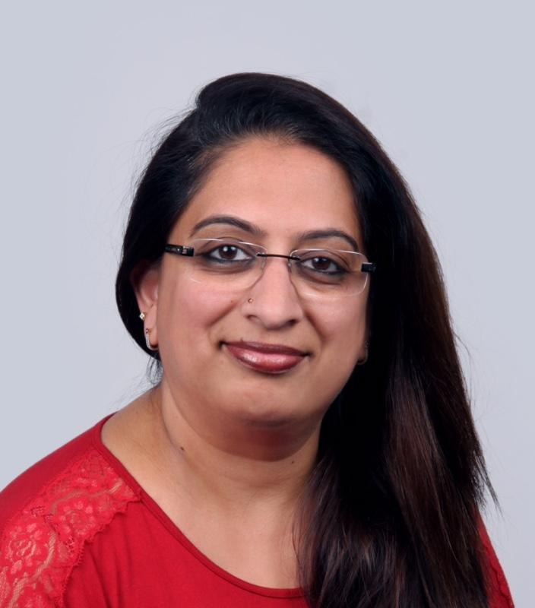
Dr. Anuradha Rao, COUNCIL MEMBER
INDIA and UAE Business COUNCIL, WICCI
Anuradha comes with a total of 30 years of experience in the area of Human Resources. She has held several leadership positions in the corporate world with organizations like GE, IBM BTO Operations, Deutsche Bank, and HR Head for Mphasis and Genpact. She is the Founder & Principal Consultant of LeAd Solutions and works with Organizations and Educational Institutions in designing, developing and Implementing Learning Solutions. Anuradha has worked with schools in the area of Teacher Training Programs in the area of Emotional Intelligence, Concept Formation, and Student Counselling. She was associated with Tatva Global School, Hyderabad and Aziz English Medium School (Rajnandgaon, Chhattisgarh) in the capacity of HR consultant and on teacher development programs. She is the Board of Directors for NCL VEKA Ltd. She has officiated as Dean of Academics at ACFM (Annapurna College of Film and Media).

Slide 18
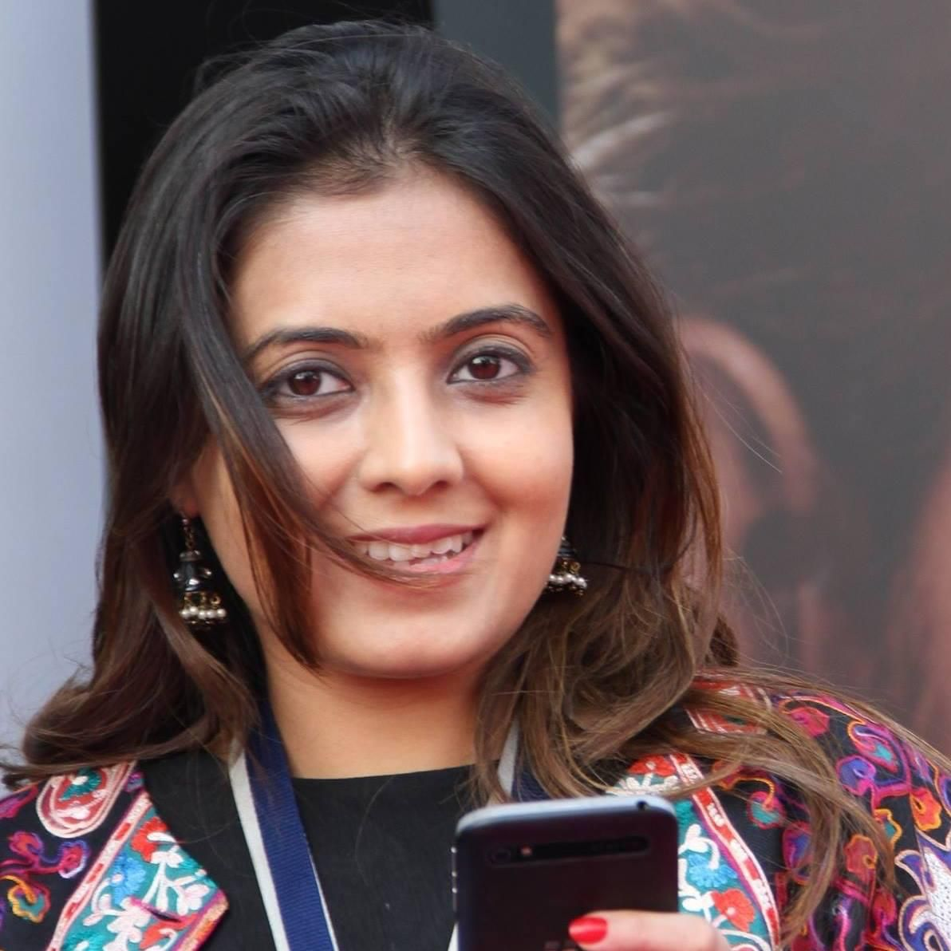
Kruti, COUNCIL MEMBER
INDIA and UAE BUSINESS COUNCIL, WICCI
Media professional by day and an art & cultural promoter by passion, Kruti has many personal and professional achievements to her credit. Currently, she spearheads marketing for the region’s leading television channels MBC4 and MBC Bollywood. Amongst her professionals achievements, Kruti is most proud of leading the launch of television channel MBC Bollywood.
Kruti’s love affair with media started 17 years back and she has worked as a Media Planner, Radio Programmer and TV Research executive in her previous experiences. A majority of her work experience has been for the MENA region.
Apart for this, Kruti is also the co-founder of Malhaar- a leading Indian Performing Arts space in Dubai. Malhaar brings together artists from across the country and provide a platform for musical exchange

Slide 19
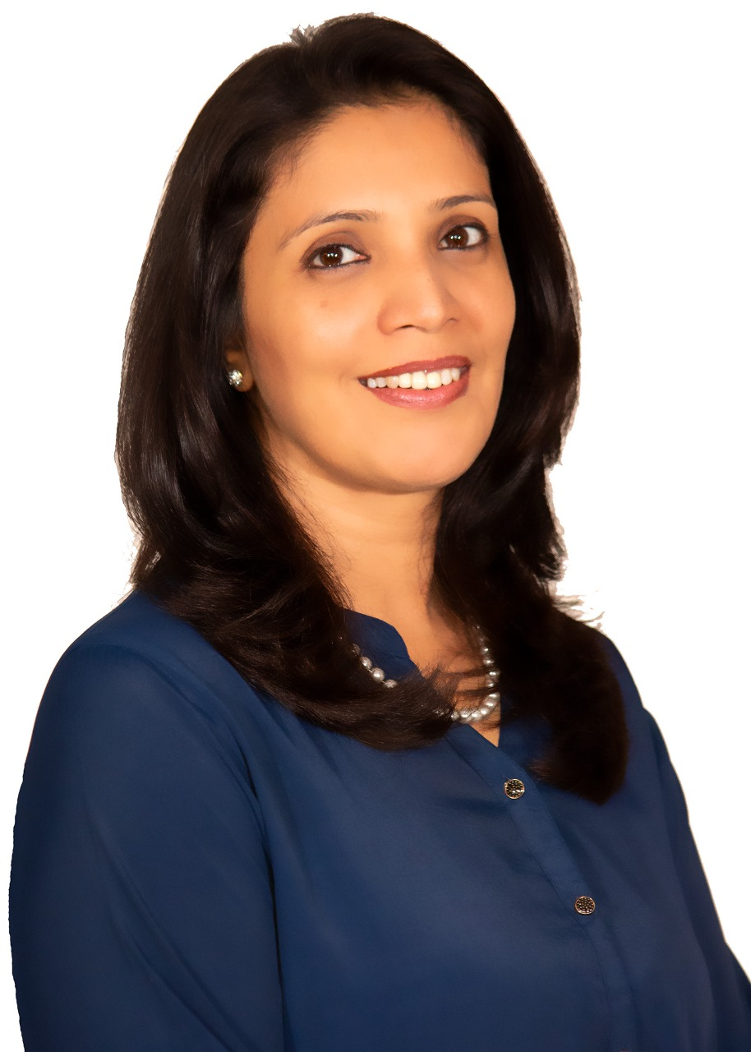
Gunngun Arora, COUNCIL MEMBER INDIA and UAE Business COUNCIL, WICCI
Gunngun has over 25 years of experience establishing and leading Corporate Communications for various organisations such as Taj Group of Hotels, American Express, Adidas, Tesco and ANZ Bank. Gunngun's work entails counselling and rendering strategic advice to leadership teams and business leaders to ensure open, honest, consistent communication and leverage a host of interactive, physical and digital channels which pitch the company as the 'Employer of Choice’. She has led developmental and community empowerment programs, which formed high-performing CSR committees. Presently, she works as a CSR and Communications consultant. Ultimately, an affable guest lecturer and active participant in panel discussions regarding CSR and NGOs, Gunngun upholds the essence of creative communication and the role of innovative advertising and marketing in CSR.

Slide 20
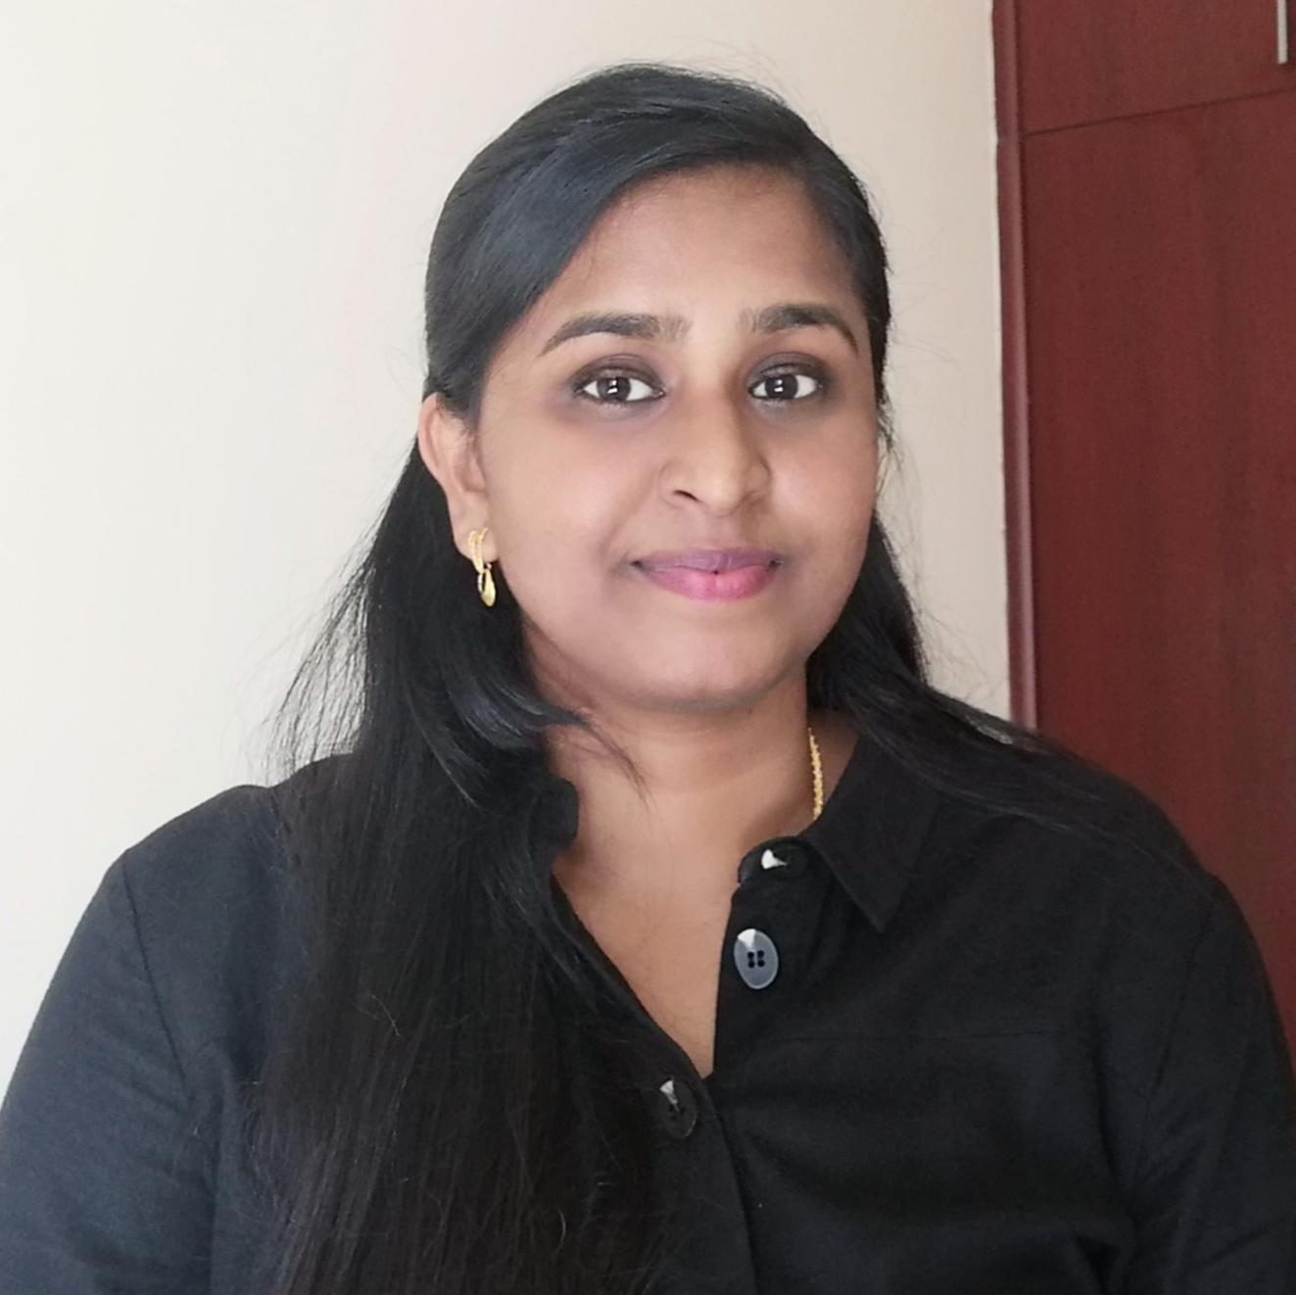
Dr. Raji Arabi, COUNCIL MEMBER INDIA and UAE Business COUNCIL, WICCI
Consultant Homoeopathic Physician / Executive Wellness Consultant / Author
A Soul heart Homoeopathic physician having 10+ years of experience in clinical excellence and treating various types of Organic diseases, functional disorders, and psychosomatic diseases.
A proven multi-unit leader, with 10 years of experience in building, training, and motivating teams to provide superior Healthcare service and full execution of operation professionals.
With Strong Medical & Administrative background along with academic, professional & Leadership skills, evolved additionally as Executive Wellness Consultant, coaching working professionals to manage and alleviate stress through a Healthy mindset, Lifestyle and other preventive measures pertaining to the particular profession and advocating the need for Holistic Wellness in society through articles, videos and posts.
Published 80+ articles related to 360-degree Health & Wellness, Leadership, Emotional intelligence, and Homoeopathy.
One of the 100 Global creators at Tealfeed, writing exclusively about “Mental Health & Wellness for Working Women”
Published an E-book “Managing Stress- A Practical Guide with Professional approach

Slide 21
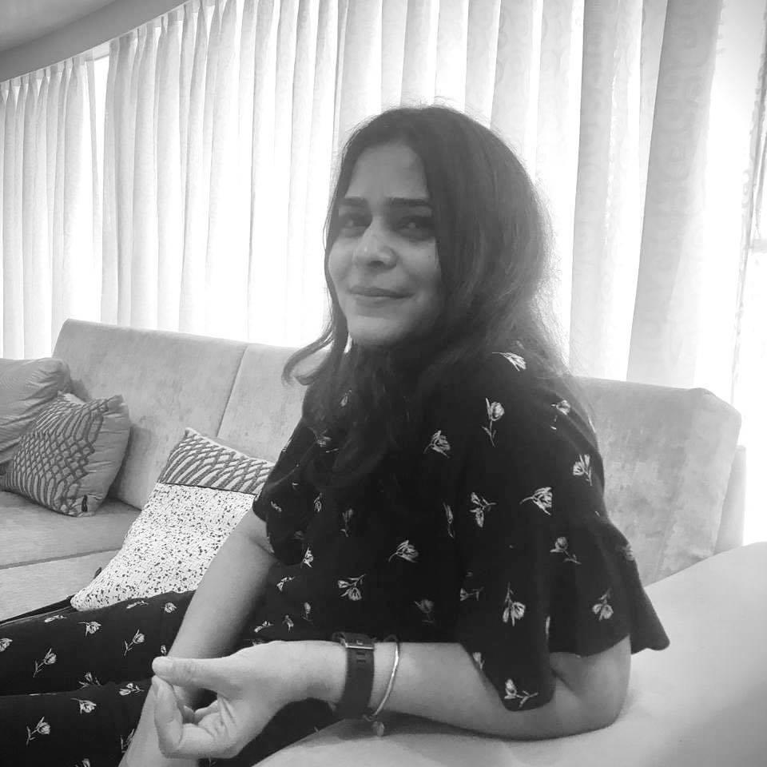
POOJA, COUNCIL MEMBER
INDIA and UAE BUSINESS COUNCIL, WICCI
Starting out at India’s most prestigious agency - Ogilvy Bombay, Pooja moved to London to work in a startup, before finally finding her calling in the multi-disciplinary agency Wunderman and then moving on to FCB Global to handle one of the region's most reputable accounts.
After consulting with IBM IX studios,she decided to take the plunge into entrepreneurship andfounded an independent agency called Asia in 2014.
Recipient of over 90+ international and regional creative awards and also the winner of the first and only Direct Cannes Lion Gold in the Middle East.
Last few notable assignments
• The set up of the Microsoft creative hub for 18 countries across Middle East & Africa
• Migrating an agency into a 80% digital offering internally and externally with clients
• The national year long campaign for Etihad Airways celebrating UAE's 50th year.

Slide 22
Sarbani Bhatia, COUNCIL MEMBER
INDIA and UAE BUSINESS COUNCIL, WICCI
A veteran technology professional with a rich experience of over three decades in the industry, thought leader and technology evangelist is how I would like to describe myself. I am an alumnus of BITS, Pilani. I started my career with a multinational computer manufacturing and software development company called ICIM and today, I head the IT function of the Jagran group. Jagran Prakashan Ltd (JPL) is one of the largest media conglomerates in the country with interests spanning across print, radio, digital, out-of-home advertising, brand activation & experiential advertising. In the IT Leadership role, my focus is more on driving the enterprise digital transformation, thereby bringing about strategic organizational changes through innovation ,intelligence and operational excellence. I interact with the Senior Management to evolve the strategic vision and drive change within the Enterprise through IT.

Slide 23
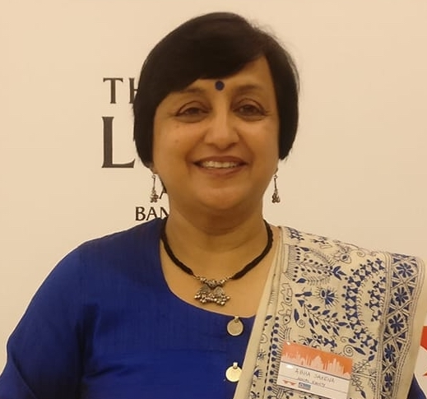
Abha Saxena, COUNCIL MEMBER INDIA and UAE Business COUNCIL, WICCI
Abha Saxena is the founder of Social Equity Advisory Services(www.socialequity.co.in ), a consulting firm focusing on Accessibility & Inclusion of persons with disabilities at the workforce & NGO Advisory Services. In her 2+ decades of experience at various leadership positions as strategic marketing and key account management specialist, she has also donned the mantle of leading CSR in the companies, she has worked with. As Vice President Programs of the NASSCOM Foundation, she successfully led the Business responsibility & Disability Initiatives of the organization, providing them with strategic direction. In Accessibility and Inclusion space, Social Equity supports organizations in becoming a ‘Disability Inclusive and RPWD16 Compliant Organization’. Social Equity pioneers in its service offering and has supported several small and large organizations in their endeavour to become accessible and inclusive. Abha is a certified CSR professional by World Bank and IFC, certified GRI 3 & 4 professional, certified Independent Director from IOD and certified Career Development & Retention of People with Disability profession by SG Enable, Singapore.

Slide 24
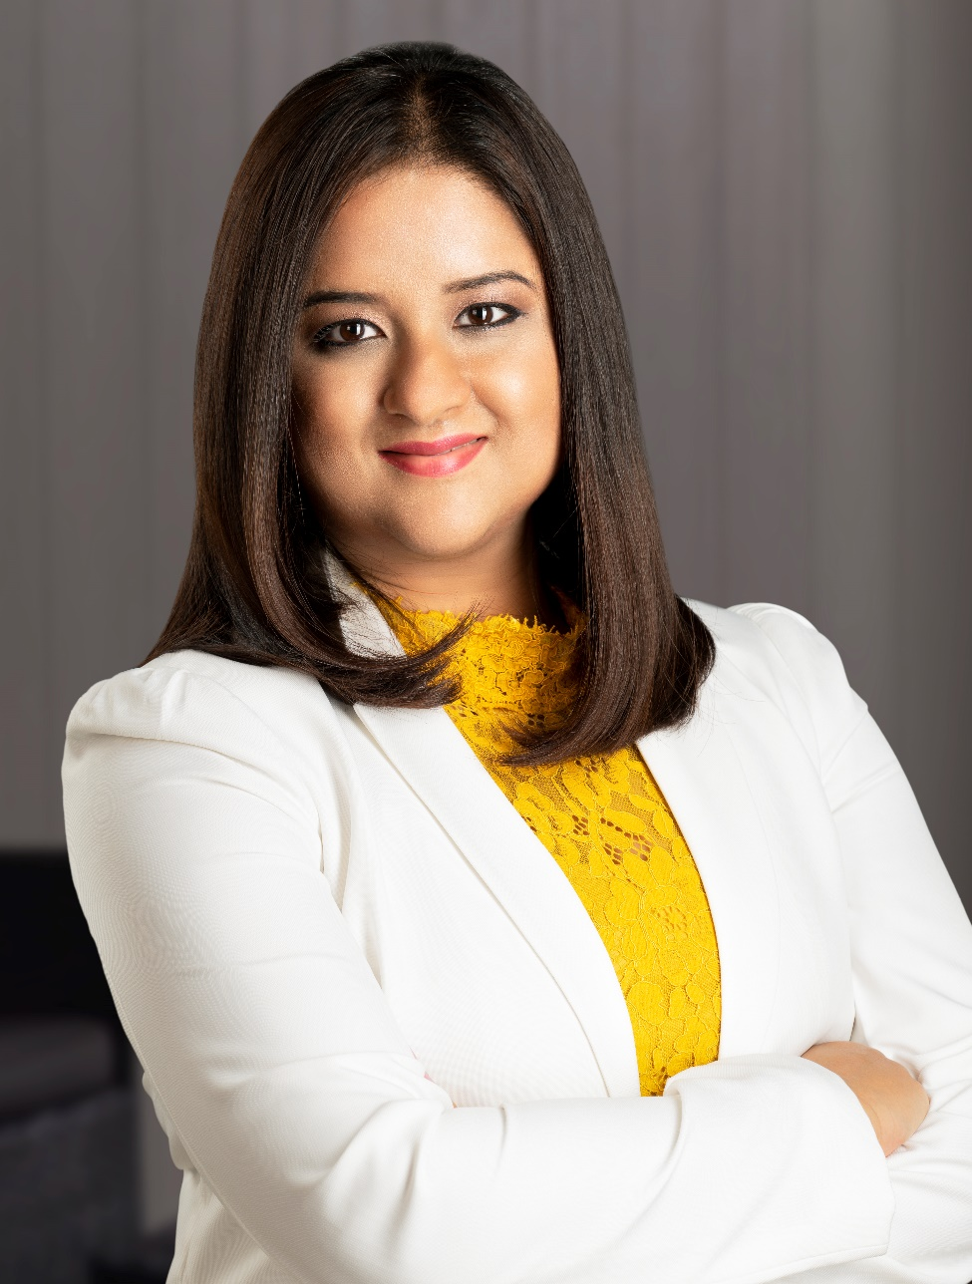
Dia Mitra, COUNCIL MEMBER
INDIA and UAE Business COUNCIL, WICCI
Dia is deeply fascinated by what makes people flourish. People and their potential are her passions. Dia holds a Bachelor of Economics from Lady Shri Ram College, Delhi and a Postgraduate in Human Resources from Tata Institute of Social Sciences, Mumbai. She is an ACC -ICF Certified Coach, Marshal Goldsmith Stakeholder Centric Coach, Accredited MBTI Practitioner and a certified Expert in Emotional Intelligence and Competency Coding. She also holds a Certificate in Training & Assessment (Australia). Dia works currently as a Leadership Coach and Training Consultant with several organisations across Asia to build strong leaders and impactful teams.

Slide 25
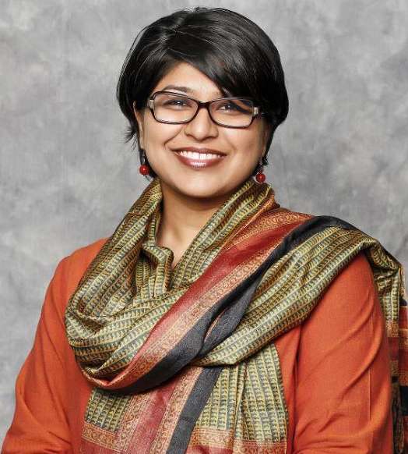
Elizabeth Sen, COUNCIL MEMBER, INDIA and UAE Business COUNCIL, WICCI
Elizabeth Sen is the chief client officer for the Middle East and North Africa (MENA) region, and is based in APCO Worldwide’s Dubai office. In this capacity, she engages the organization in managing client relationships, revenue and profit. She brings to her position a deep understanding of client expectations, the entire lifecycle of the client and what metrics actually matter to understand these components. Her focus areas include holding companies and multinationals in the real estate, education, retail, technology and tourism sectors.

Slide 26
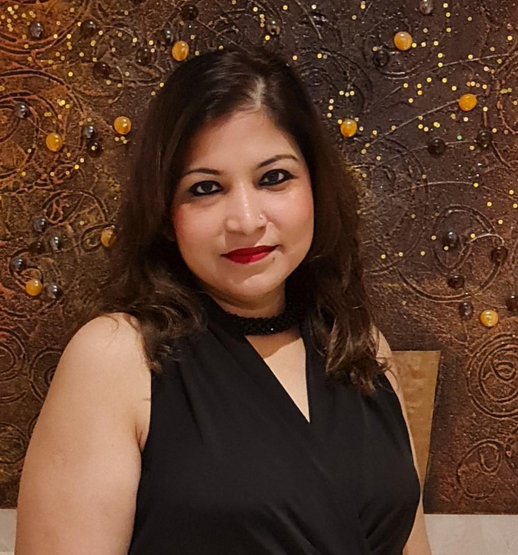
Sadia Khan, COUNCIL MEMBER
INDIA and UAE Business COUNCIL, WICCI
Experienced Banker with more than 20 years of work experience, I am originally from Mumbai and a Dubai resident from 2003.
Besides being a banker, I am also a mom to an adorable 9-year-old princess.
My interests are travelling, acting and participating in outdoor activities.
Although I have a master’s degree in Economics, my favourite subject has always been Psychology.
Therefore, if not a Banker I would have definitely been Clinical Psychologist.
My motto in life is “ Live life kingsize”
Post my job redundancy in Oct 2020 I have become a fitness freak having successfully lost a whopping 35 kg.

Slide 27
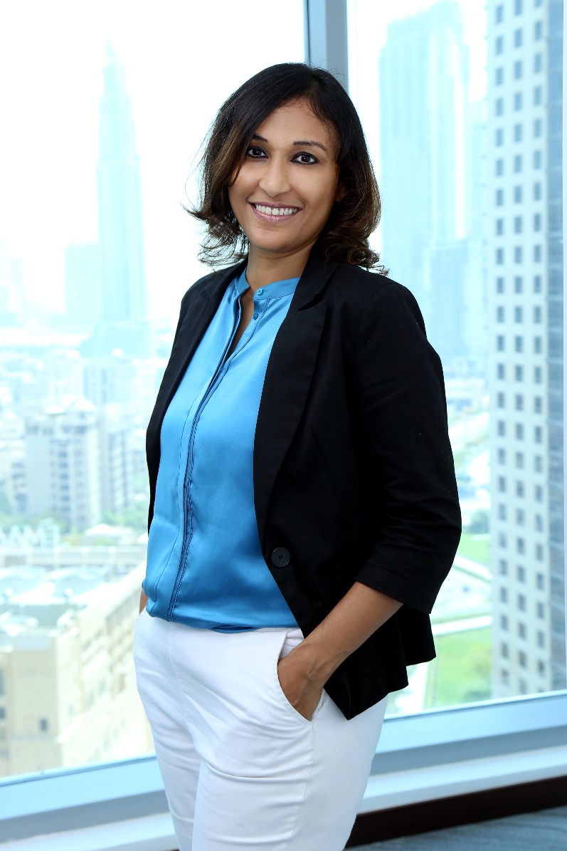
Nasheeda, COUNCIL MEMBER
INDIA and UAE Business COUNCIL, WICCI
Nasheeda (Nish in short) is the Founder and Managing Director of Nishe, an all-women boutique professional services firm specialised in provision of accounting, VAT, consulting and related services to clientele in the GCC. Nishe’s ultimate purpose is to become a socio-commercial organisation, i.e. an organisation that is commercially successful and at the same time socially relevant. Nishe aspires working towards supporting and empowering women by providing them the required support to grow. At Nishe, Nasheeda works closely with clients from different industries assisting them with various aspects of accounting, audit, tax and related services. She is also an experienced trainer on these topics. Prior to setting up Nishe, Nasheeda worked with PricewaterhouseCoopers Dubai for more than 11 years. She served as the Assurance Director in PwC for two years till September 2016 before deciding to set up her own firm. Before PwC, Nasheeda managed the local branch of an international IT company for three years. Nasheeda is an FCCA. She has completed MSc in Professional Accountancy from the University of London and also has a Bachelor degree in Business from Calicut University. She is an ACCA Certified Business Valuer. Nasheeda is a Member of the Members Advisory Committee (MAC) of ACCA UAE and the ACCA Global Tax Forum. She is always on the lookout for new learning, new challenges and new experiences, constantly involved in diverse activities such as taking part in the 2020 UAE Women’s Heritage Walk, trekking and learning piano. She blogs on technical matters as well as other topics such as entrepreneurship and women in society. Nishe and Nasheeda have been featured in press several times particularly for the women-focus and have also won awards like the Best Boutique Accounting Services Firm – Dubai by Acquisition International and Best CEO Middle East in Accountancy by CEO Today Magazine. Nasheeda is married with two kids. She has lived in Dubai since 1991.

Slide 28
SUPPORTED BY
WICCI is supported by the massive global networks of ALL Ladies League (ALL), Women Economic Forum (WEF), and SHEconomy.
ALL is a movement of ‘Sisters Beyond Borders.’
WEF is a platform for ‘Business Beyond Borders.’ SHEconomy is e-commerce for women worldwide in Goods & Services for ‘Commerce Beyond Borders’

Slide 29
COUNTRIES REPRESENTED
Albania, Angola, Armenia, Argentina, Australia, Azerbaijan, Bangladesh, Brazil, Burundi, Cameroon, Canada, Chad, China, Costa Rica, Croatia, Cyprus, Czech Republic, Colombia, Ecuador, Egypt, Ghana, Germany, Greece, Guatemala, Hong Kong, Hungary, India, Italy, Israel, Ireland, Japan, Kazakhstan, Kenya, Kyrgyzstan, Lesotho, Luxembourg, Malawi, Malaysia, Mexico, Moldova, Monaco, Montenegro, Morocco, Mozambique, Malta, Netherlands, Nigeria, Nepal, New Zealand, North Macedonia, Norway, Paraguay, Portugal, Peru, Puerto Rico, Philippines, Qatar, Romania, Russia, Rwanda, Serbia, Singapore, Slovenia, Spain, South Africa, South Korea, Suriname, Sweden, Switzerland, Syria, Tunisia, Turkey, Uganda, Ukraine, UK, Uruguay, Venezuela, Vietnam, Virgin Islands (US), UAE, USA, Uzbekistan, Zimbabwe.

Slide 30
WOMEN'S INDIAN CHAMBER OF COMMERCE ANDINDUSTRY

